Slide 1


The Anatomy of a Landing Page

Slide 2
1
HOW DO YOU USE A LANDING PAGE?

Slide 3
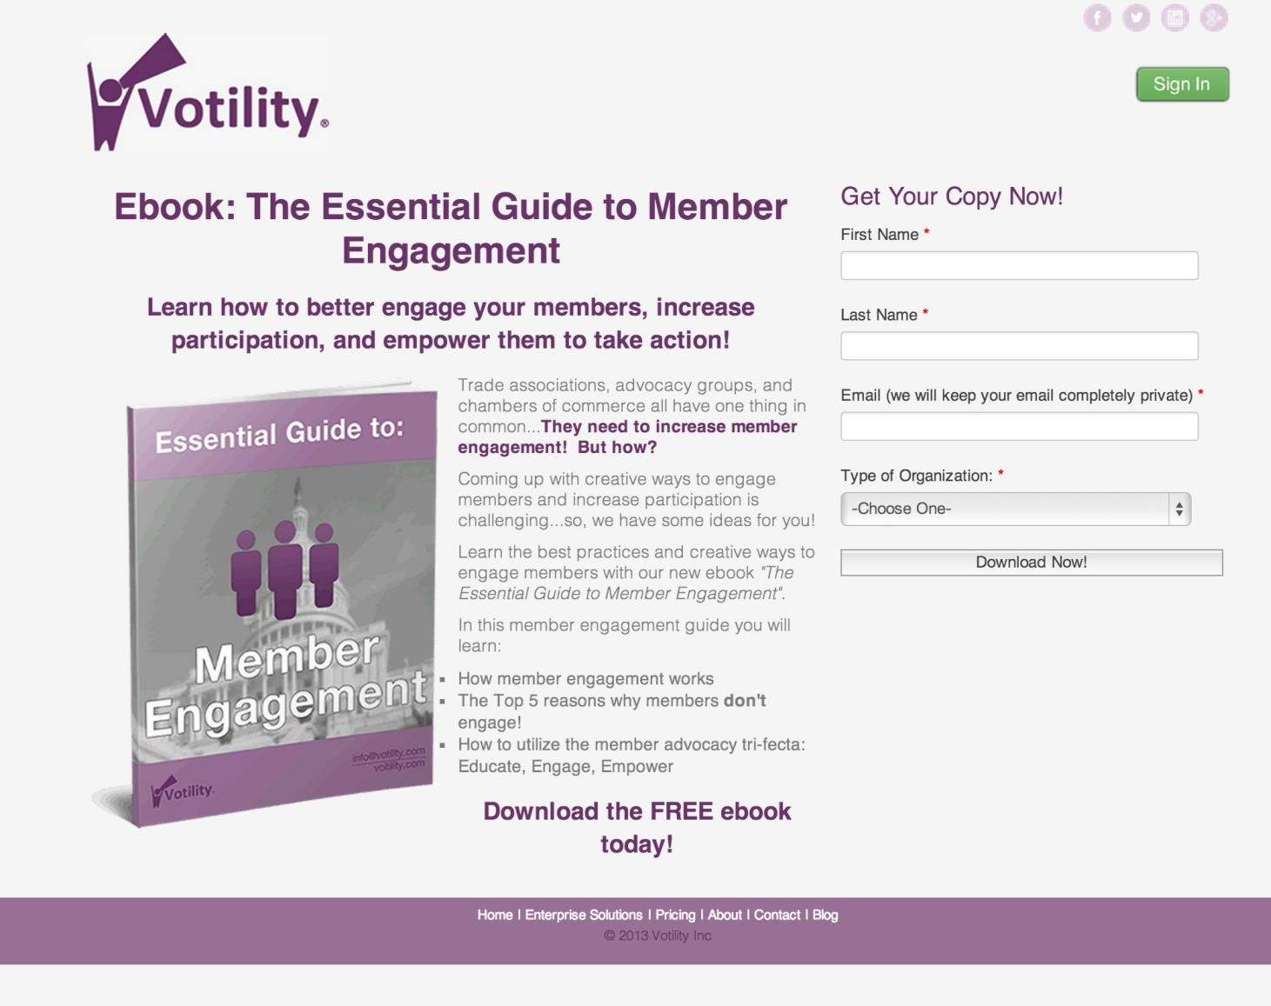
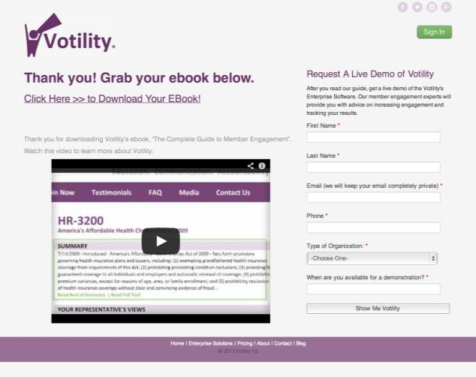
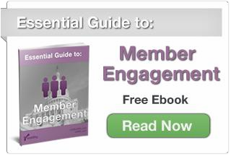

The Conversion Process
Call-to-Action
Landing Page
Thank You Page

Slide 4


Landing pages are your digital sales reps.

Slide 5
All landing pages use a form to gather information.

Slide 6
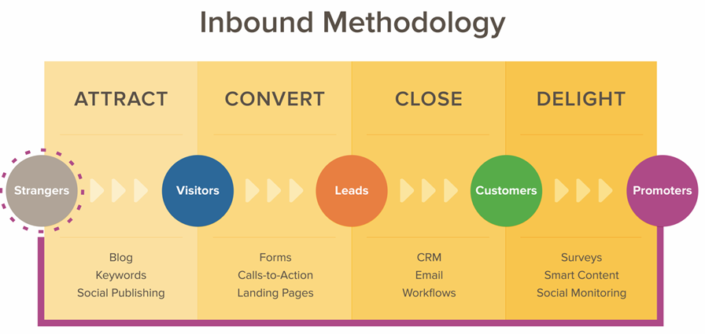

Slide 7
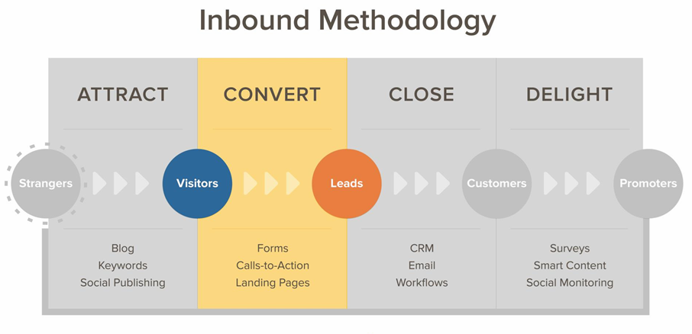

Slide 8
2
HOW DO YOU CREATE SUCCESSFUL LANDING PAGES?

Slide 9
20%
Landing page conversion rate goal.

Slide 10
GET READY FOR A BLINK TEST.

Slide 11
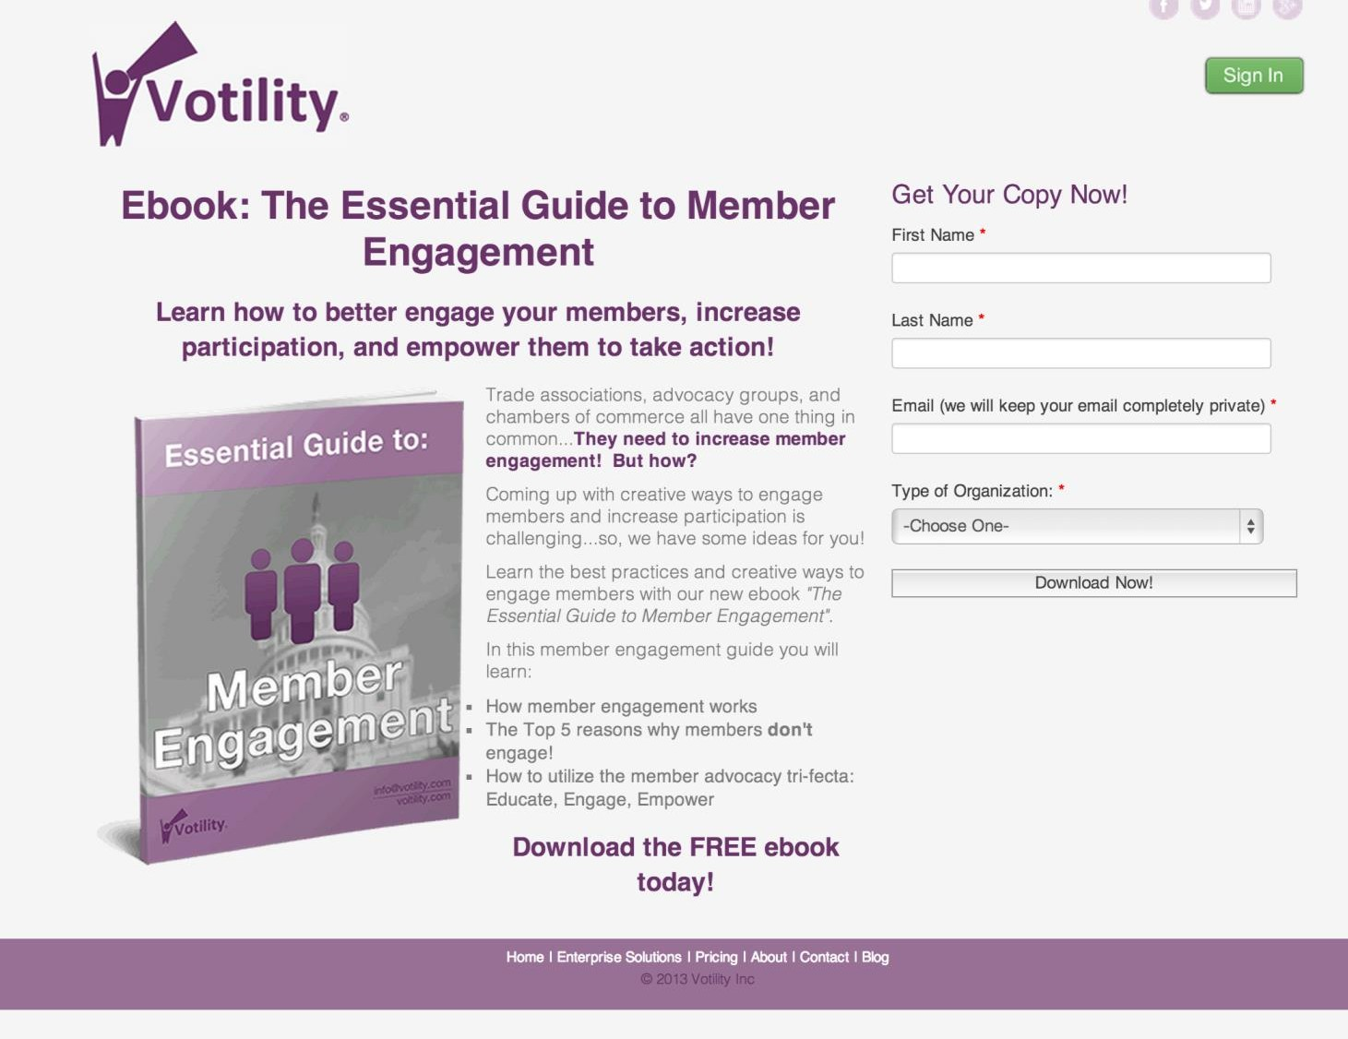

Slide 12
WHAT WAS THE LANDING PAGE ABOUT?

Slide 13

LANDING PAGE BEST PRACTICES
Write a clear, concise action-oriented headline.
Explain the offer clearly and place visual emphasis on the value. Remove the navigation menu and links.
The form length mirrors the value of the offer.
Include a relevant image, animation or short video. Add social sharing icons.

Slide 14
LANDING PAGE BEST PRACTICES
Write a clear, concise action-oriented headline.
Explain the offer clearly and place visual emphasis on the value. Remove the navigation menu and links.
The form length mirrors the value of the offer.
Include a relevant image, animation or short video. Add social sharing icons.

Slide 15
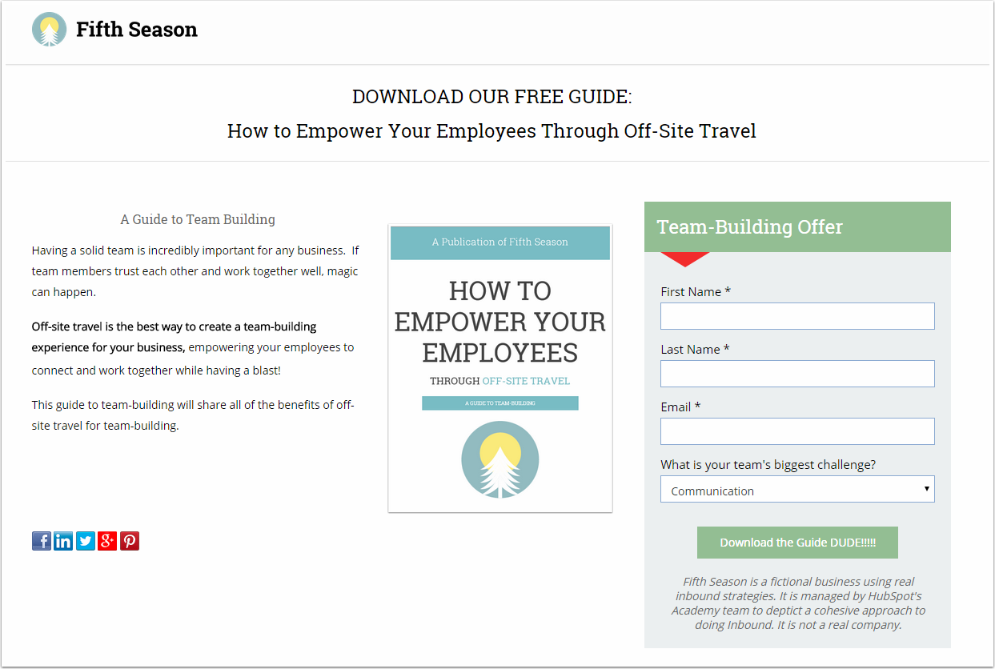
Write a clear, action-oriented headline.
Tell your visitors what they’re getting and how they are going to access it.

Slide 16
LANDING PAGE BEST PRACTICES
Write a clear, concise action-oriented headline.
Explain the offer clearly and place visual emphasis on the value. Remove the navigation menu and links.
The form length mirrors the value of the offer.
Include a relevant image, animation or short video. Add social sharing icons.

Slide 17
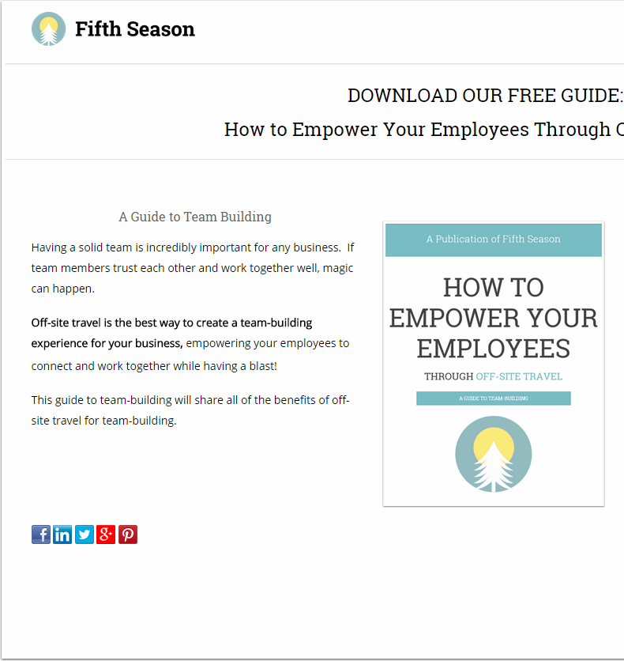
Explain the offer and its value, and keep it short.
In 1-3 sentences, explain what the offer is. Write another 1-3 sentences that details how someone would
benefit from the offer.

Slide 18
Use numbers, bullets
and bolding.
Help your visitor focus on what’s important
with visual emphasis.

Slide 19
LANDING PAGE BEST PRACTICES
Write a clear, concise action-oriented headline.
Explain the offer clearly and place visual emphasis on the value. Remove the navigation menu and links.
The form length mirrors the value of the offer.
Include a relevant image, animation or short video. Add social sharing icons.

Slide 20
Remove the navigation menu and links.
The primary goal of your landing page is to generate leads, so get rid of any distractions.

Slide 21
LANDING PAGE BEST PRACTICES
Write a clear, concise action-oriented headline.
Explain the offer clearly and place visual emphasis on the value. Remove the navigation menu and links.
The form length mirrors the value of the offer.
Include a relevant image, animation or short video. Add social sharing icons.

Slide 22
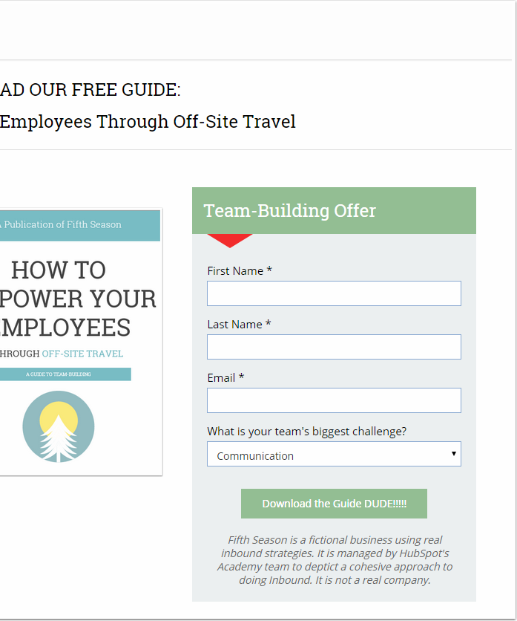
The form on the landing page should mirror the value of the offer.

Slide 23
THE CONVERSION PROCESS CAN OCCUR DURING WHICH OF THE FOLLOWING BUYER’S JOURNEY STAGES?
Awareness Stage
Consideration Stage
Decision Stage
All of the above.

Slide 24
THE CONVERSION PROCESS CAN OCCUR DURING WHICH OF THE FOLLOWING BUYER’S JOURNEY STAGES?
Awareness Stage
Consideration Stage
Decision Stage
All of the above.

Slide 25
LANDING PAGE BEST PRACTICES
Write a clear, concise action-oriented headline.
Explain the offer clearly and place visual emphasis on the value. Remove the navigation menu and links.
The form length mirrors the value of the offer.
Include a relevant image, animation or short video. Add social sharing icons.

Slide 26
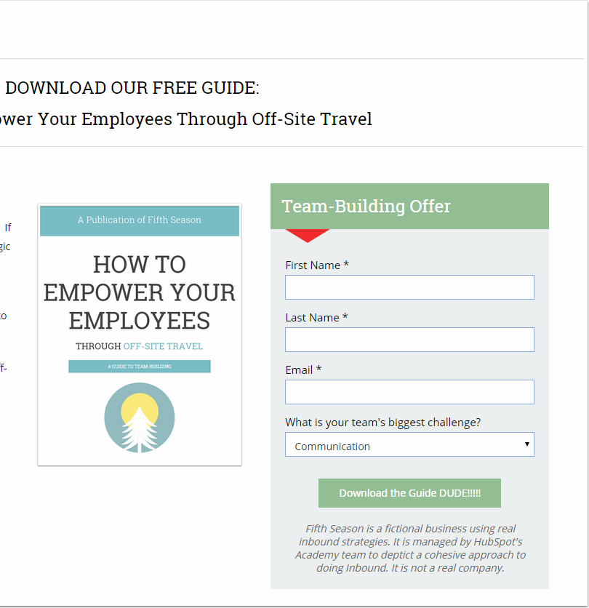
Include a relevant
image, animation or
short video.
A visual representation can communicate the offer much quicker than a visitor can
read about the offer.

Slide 27
LANDING PAGE BEST PRACTICES
Write a clear, concise action-oriented headline.
Explain the offer clearly and place visual emphasis on the value. Remove the navigation menu and links.
The form length mirrors the value of the offer.
Include a relevant image, animation or short video. Add social sharing icons.

Slide 28
Add social sharing icons to allow your visitor to spread the word with others in their networks.

Slide 29
LANDING PAGE BEST PRACTICES
Write a clear, concise action-oriented headline.
Explain the offer clearly and place visual emphasis on the value. Remove the navigation menu and links.
The form length mirrors the value of the offer.
Include a relevant image, animation or short video. Add social sharing icons.

Slide 30
3
WHAT DOES AN EFFECTIVE LANDING PAGE LOOK LIKE?

Slide 31
BLINK TEST

Slide 32


Slide 33
CAN YOU LIST THE BEST PRACTICES THAT ARE BEING IMPLEMENTED ON THE LANDING PAGE?

Slide 34
CAN YOU LIST THE BEST PRACTICES THAT ARE BEING IMPLEMENTED ON THE LANDING PAGE?
A.Clear, concise, action-oriented headline.

Slide 35
CAN YOU LIST THE BEST PRACTICES THAT ARE BEING IMPLEMENTED ON THE LANDING PAGE?
Clear, concise, action-oriented headline.
Explains the offer clearly.

Slide 36
CAN YOU LIST THE BEST PRACTICES THAT ARE BEING IMPLEMENTED ON THE LANDING PAGE?
Clear, concise, action-oriented headline.
Explains the offer clearly.
Includes a relevant image.

Slide 37
CAN YOU LIST THE BEST PRACTICES THAT ARE BEING IMPLEMENTED ON THE LANDING PAGE?
Clear, concise, action-oriented headline.
Explains the offer clearly.
Includes a relevant image.
The form length mirrors the value of the offer.

Slide 38
CAN YOU LIST THE BEST PRACTICES THAT ARE BEING IMPLEMENTED ON THE LANDING PAGE?
Clear, concise, action-oriented headline.
Explains the offer clearly.
Includes a relevant image.
The form length mirrors the value of the offer.
No menu navigation or links.

Slide 39
Consider how your persona is
interpreting the offer.

Slide 40
Make changes one at a time.

Slide 42
THANK YOU.

